Slide 1
The Hydrogen atom problem in spherical polar coordinates
n = 1, 2, 3…
l < n
l=0,1,2,3…
|m|< l
m=0, ±1, ±2, ±3, ±4,….

Slide 2
Energy and Angular Momentum
n = 1, 2, 3…
l < n
l=0,1,2,3…
|m|< l
m=0, ±1, ±2, ±3, ±4,….

Slide 3
Radial and angular parts
n = 1, 2, 3…
l < n
l=0,1,2,3…
|m|< l
m=0, ±1, ±2, ±3, ±4,….

Slide 4
Radial Functions of Hydrogen Atom
Number of radial nodes =
n-l-1

Slide 5
1s and 2s Orbitals
Functions of only ‘r’

Slide 6
2p Orbitals
Functions of ‘r’, ‘θ’ and ‘φ’

Slide 7
2p Orbitals
Linear
combination

Slide 8
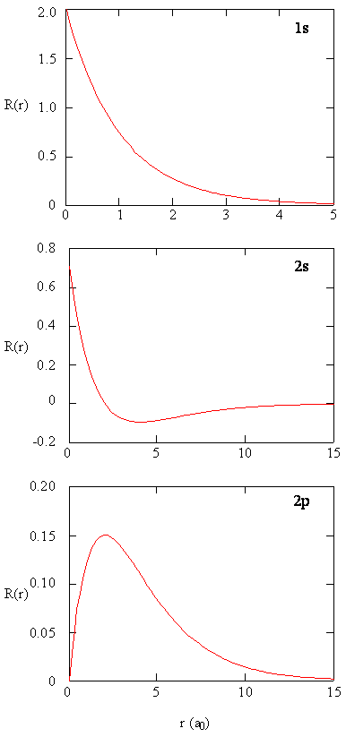
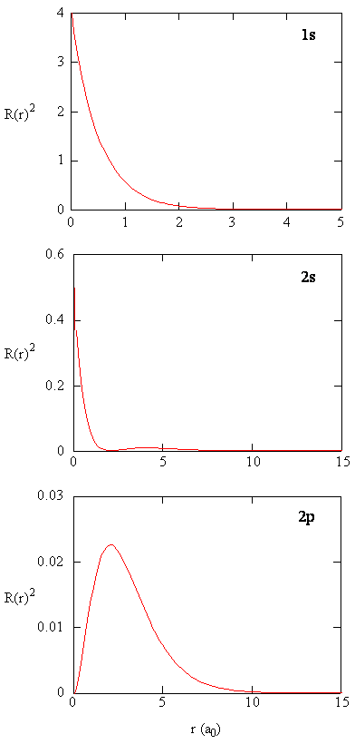
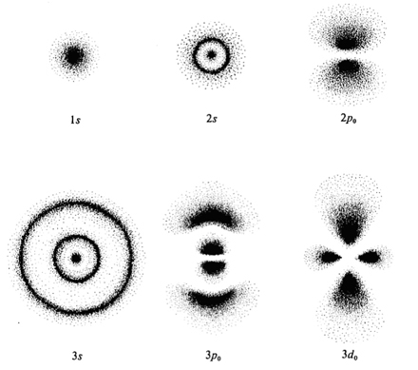
Radial functions
For s-Orbitals the maximum probability denisty of finding the electron is on the nucleus

Slide 9
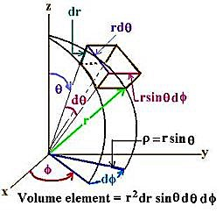

Probability: Volume element in spherical polar coordinates
For a s orbital
2
2π
Radial Probability distribution function

Slide 10
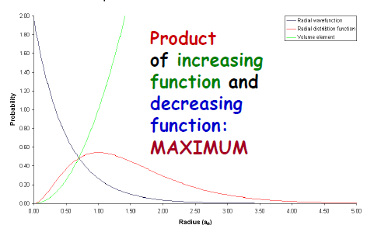
Radial Distribution Functions
For s-Orbitals :
Maximum probability denisty of finding the electron is on the nucleus
Probability of finding the electron on the nucleus zero

Slide 11
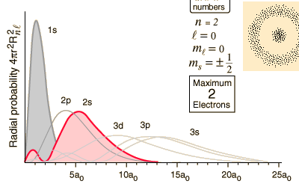

Radial Distribution Functions
Average value of radius:
Most probable value of radius:

Slide 12
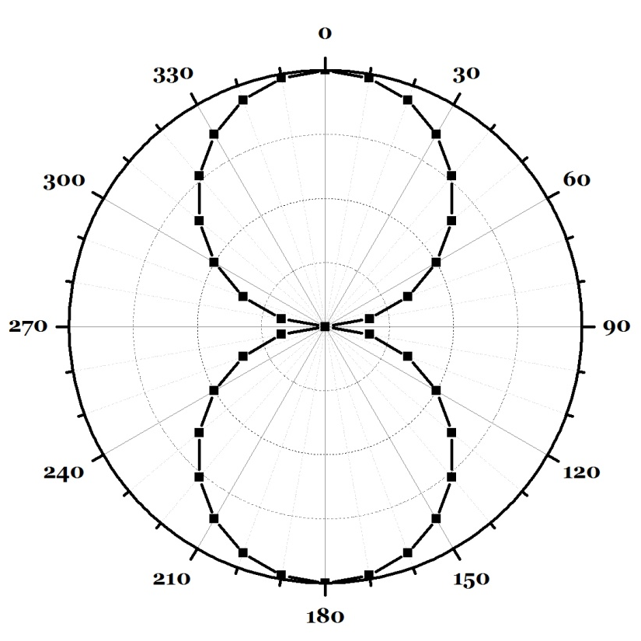
Angular Distribution Functions
p-Orbitals
Angular part: Polar plot of 2p_{z} --- cosθ
z
θ | cosθ
0 | 1.000
30 | 0.866
60 | 0.500
90 | 0.000
120 | -0.500
150 | -0.866
180 | -1.000
210 | -0.866
240 | -0.500
270 | 0.000
300 | 0.500
330 | 0.866
360 | 1.000
+
x
–

Slide 13
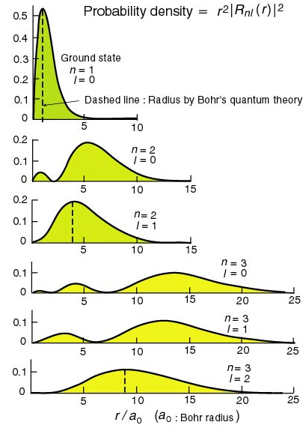
Radial Distribution Functions
Average value of radius:
Most probable value of radius:
1st derivative = 0

Slide 14

Angular Distribution Functions
p-Orbitals
Angular part: Polar plot of 2p_{z} --- cosθ
θ | cosθ
0 | 1.000
10 | 0.985
20 | 0.940
30 | 0.866
40 | 0.766
50 | 0.643
60 | 0.500
70 | 0.342
80 | 0.174
90 | 0.000
120 | -0.500
150 | -0.866
180 | -1.000

Slide 15
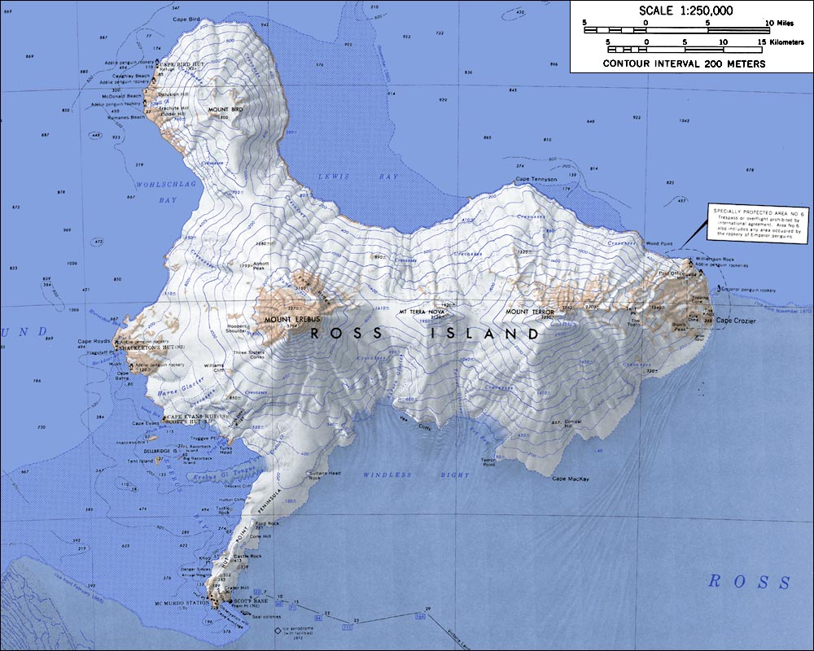
3D and contour representations

Slide 16
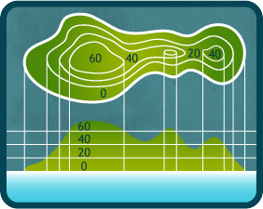
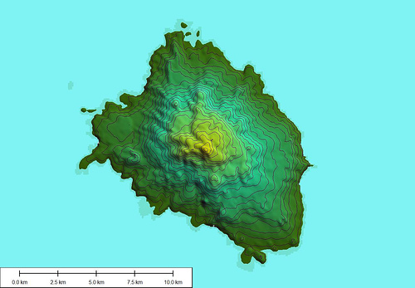
3D and contour representations

Slide 17

3D and contour representations

Slide 18
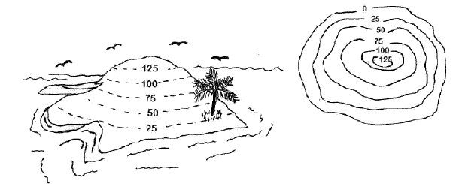
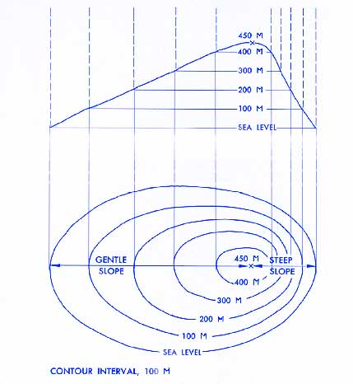
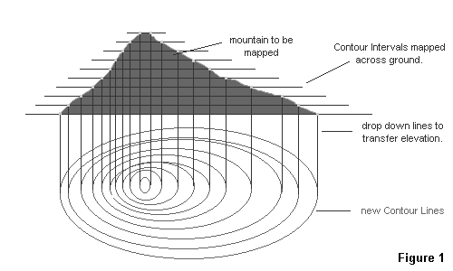
3D and contour representations

Slide 19
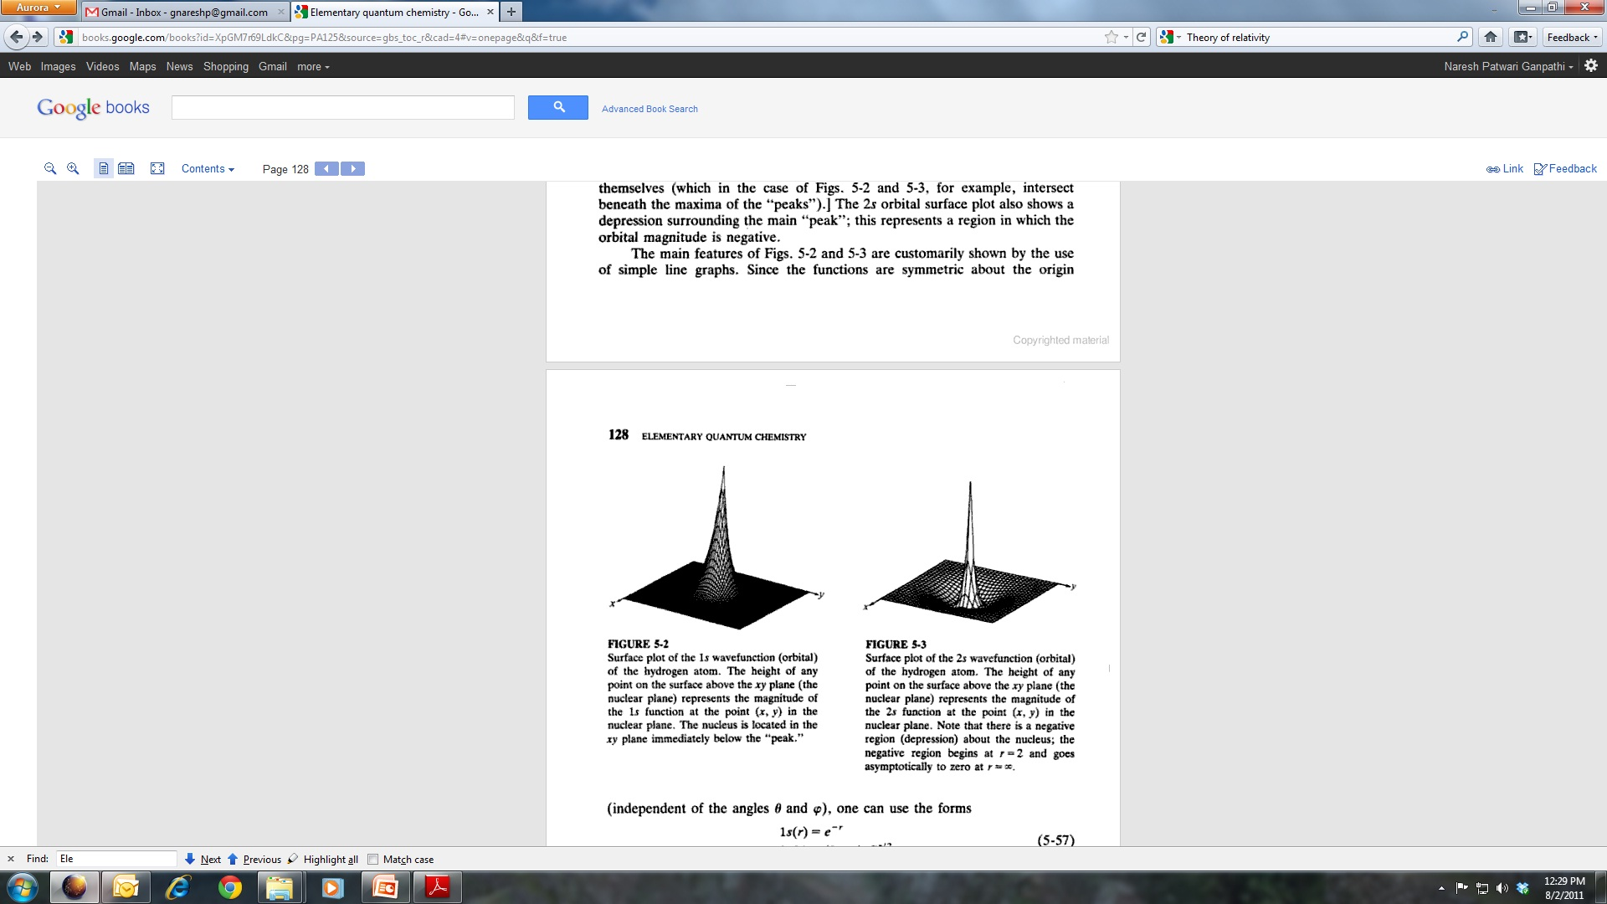
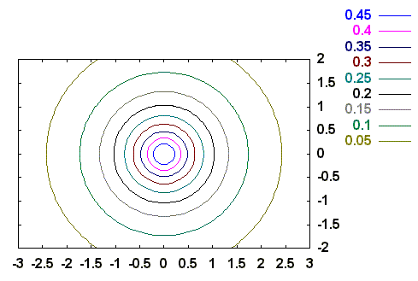
1s orbital

Slide 20
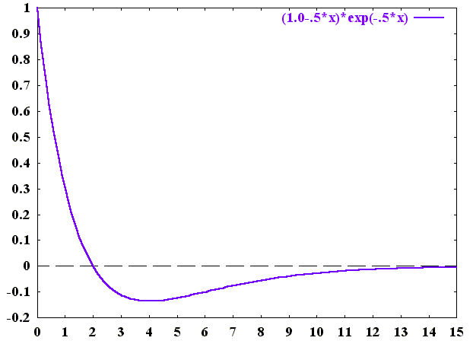
2s orbital
radial node
Y. U. Sasidhar

Slide 21
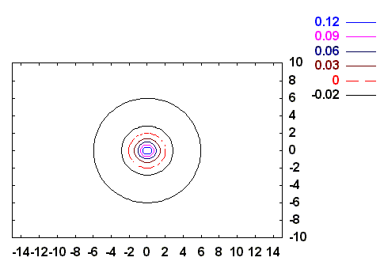
2s orbital
radial node
radial node
y/a
-
+
x/a
Y. U. Sasidhar

Slide 22
2s orbital

Slide 23
2s orbital

Slide 24
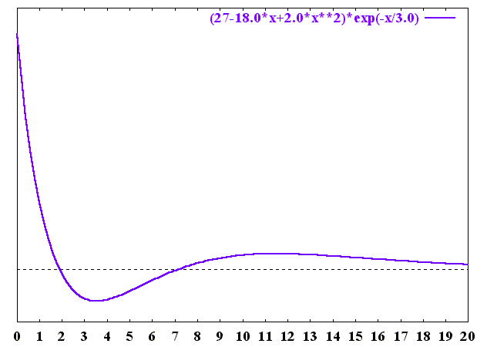
3s orbital
radial nodes
r/a

Slide 25
3s orbital

Slide 26
3s orbital

Slide 27
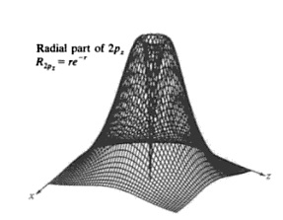
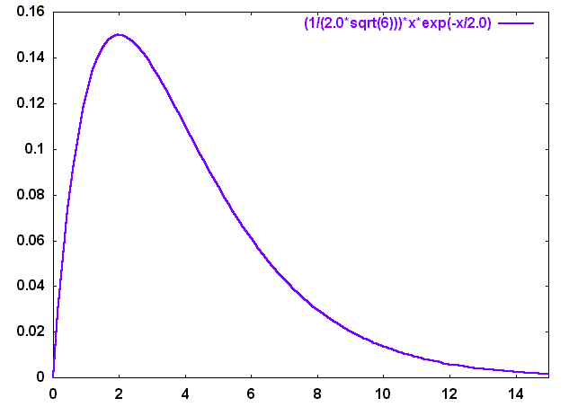
2p_{z} orbital
Angular Part
(2,1,0)
Radial Part starts with a zero at r=0; so does Ψ
No radial node !
Y. U. Sasidhar

Slide 28
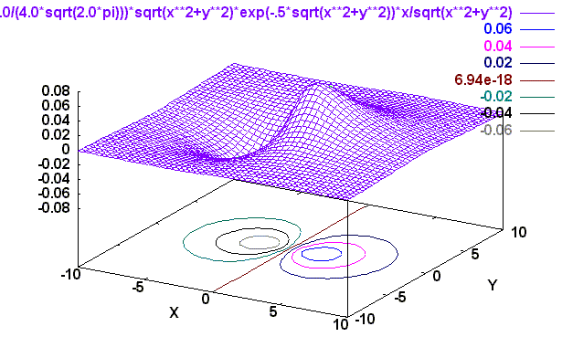
2p_{z} orbital
Angular Part
(2,1,0)
X
Z

Slide 29
2p_{z} orbital
Angular Part
(2,1,0)
X
Z

Slide 30
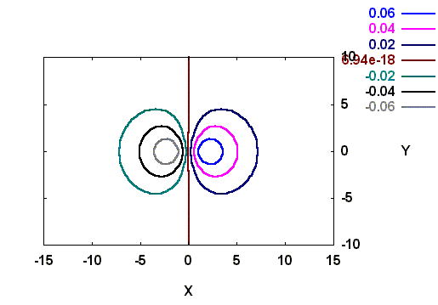
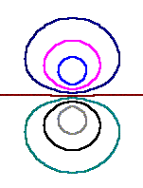
2p_{z} orbital
Angular node
z=0
same value
_
x/a
+
- ve contours
+ ve contours
z/a

Slide 31
2p_{z} orbital: Constant Probability Surface
+
_

Slide 32
2p_{z} orbital: Probability distribution as dots

Slide 33
2p Orbitals
Linear
combination

Slide 34
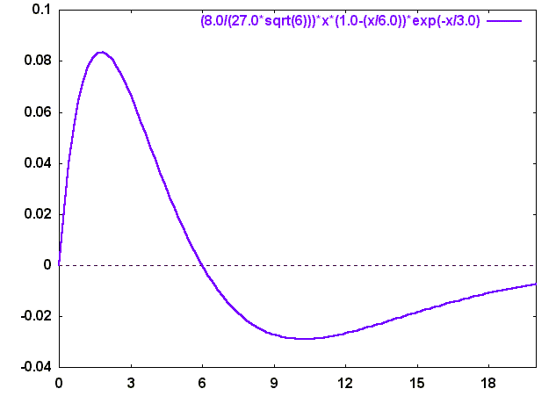
3p_{z} orbital
radial
node
R
r/a

Slide 35
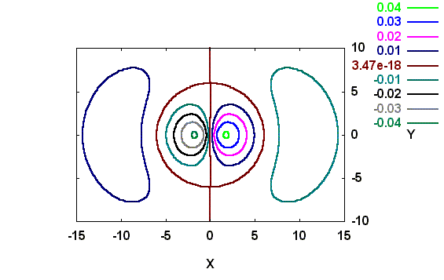
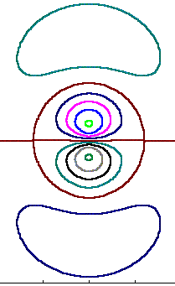
3p_{z} orbital
radial node
x/a
x/a
angular node
z/a
y=0 here

Slide 36
3pz orbital: Surface of constant probability

Slide 37
3p_{z} orbital: Probability distribution as dots

Slide 38
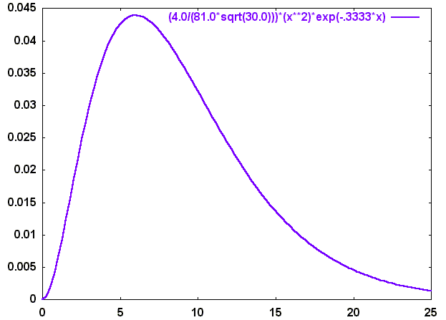
r/a

Slide 39
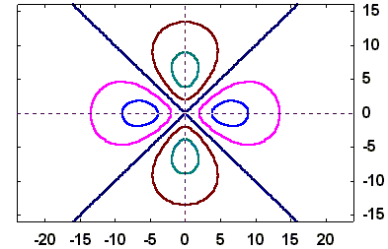
Angular nodes: x = ± y
-
+
+
y/a
-
x/a

Slide 40
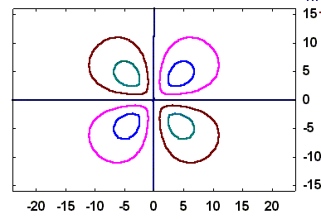
angular nodes: x=0, y=0
-
+
y/a
+
-
x/a

Slide 41
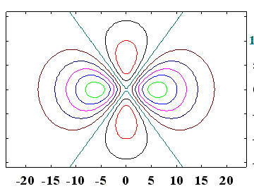
2 angular nodes
-
+
+
x/a
-
z/a

Slide 42
3dz² : Surface of constant probability

Slide 43
3dz² : Surface of constant probability with angular nodes

Slide 44
3dz² : Probability distribution as dots

Slide 45
4f₀

Slide 46
4f₀ : Nodal Surface in grey

Slide 47
is only a nickname
Full label:

Slide 48
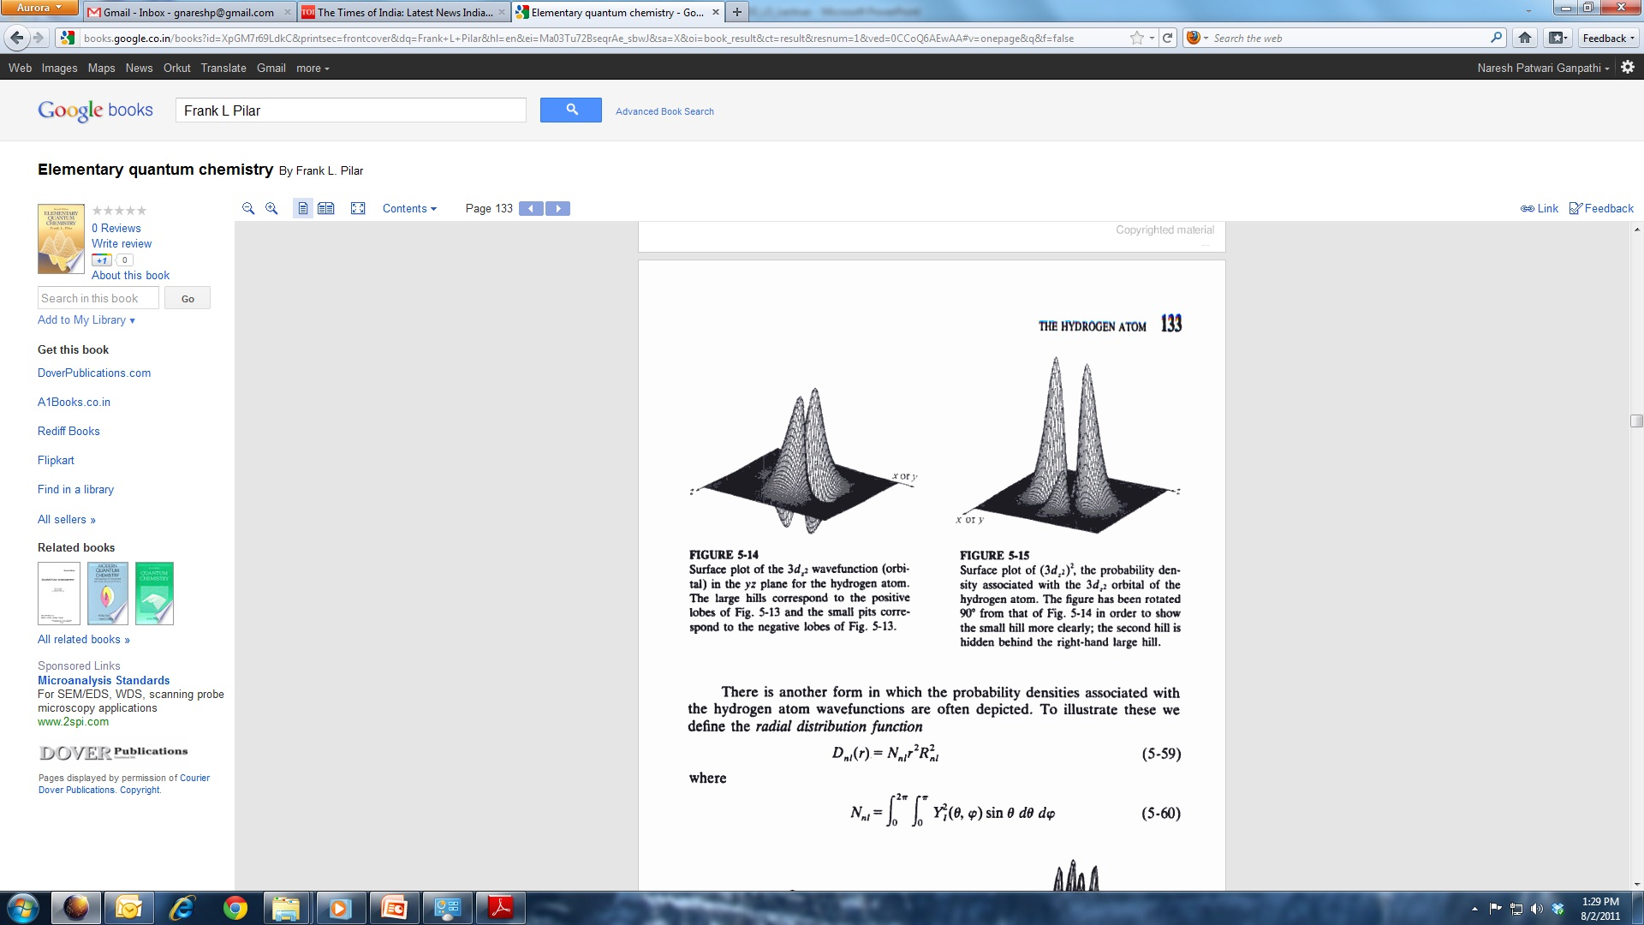
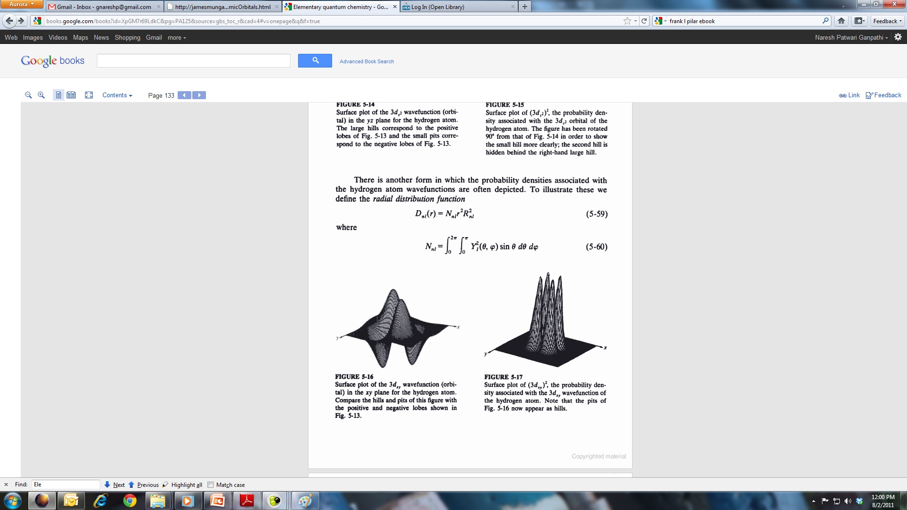
Surface plots
Surface plot of the 3d_{z2} wavefunction (orbital) in the xz (or yz) plane for the hydrogen atom. The large hills correspond to the positive lobes and the small pits correspond to the negative lobes.
Surface plot of the (3d_{z2} )² the probability density associated with the 3d_{z2} orbital of the hydrogen atom. This figure is rotated with respect to the figure on the left so that the small hill will be clearly visible. Another smaller hill is hidden behind the large hill.
Surface plot of the 3d_{xy} wavefunction (orbital) in the xz plane for the hydrogen atom. The hills and the pits have same amplitude.
Surface plot of the (3d_{xy} )² the probability density associated with the 3d_{xy} orbital of the hydrogen atom. Pits in the figure to the left appear has hills.

Slide 49
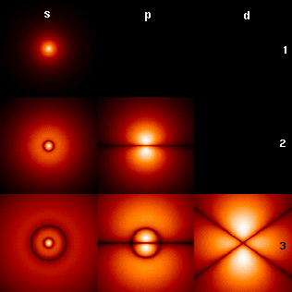
Cross-sections of Orbitals

Slide 50
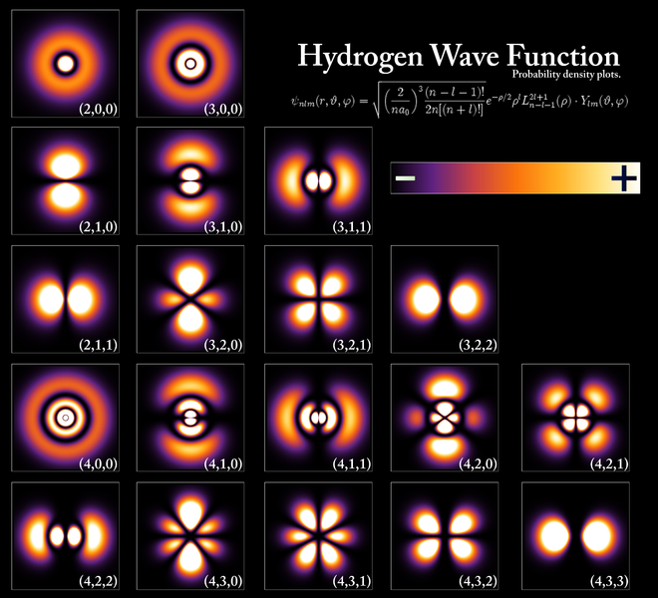
Hydrogen Wavefunctions

Slide 51
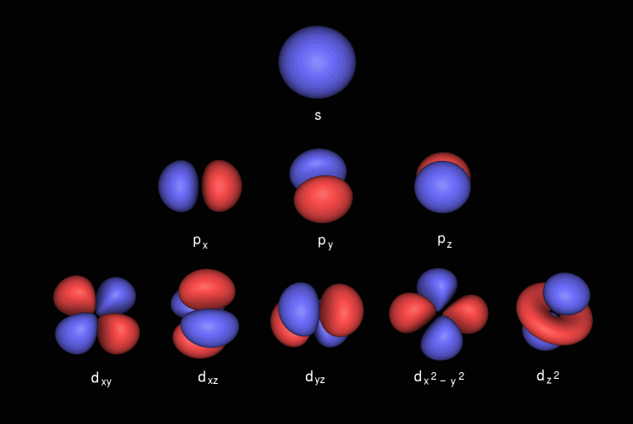
Orbitals: External Structure

Slide 52
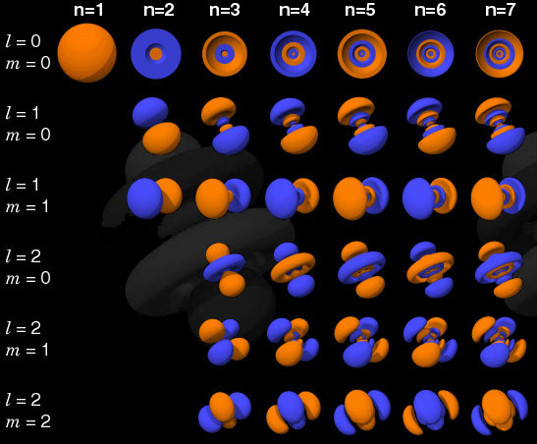
Orbitals: Internal Stucture

Slide 53
Hydrogen atom & Orbitals
Hydrogen atom has only one electron, so why bother about all these orbitals?
1. Excited states
Spectra
3. Many electron atoms

